Slide 1
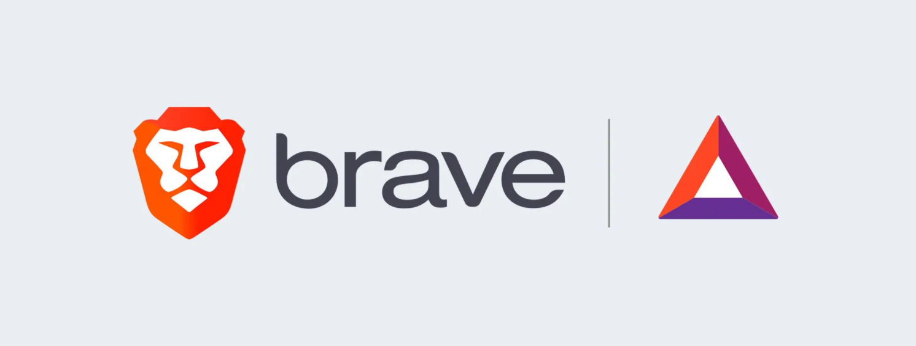
BRAVE SOFTWARE
BY HARSH SINGH

Slide 2
WHAT IS BRAVE SOFTWARE?
Developed by Brave Software, Inc., Brave is based on Chromium, a Google-sponsored free and open-source web browser. This is the same technology Google uses for its Chrome browser and Microsoft for Edge. Chromium is also the brains behind lesser-used browsers, including Amazon Silk, Opera, Vivaldi, and many more.
The Brave browser is available across many platforms, including Windows, macOS, iOS, Android, and Linux. Given the quote mentioned above, it shouldn’t come as a surprise that it heavily focuses on security and speed. This one-two punch is achieved by blocking ads and trackers automatically. Removing these pesky tools means the browser can move at faster speeds.

Slide 3
WHY I CHOOSE BRAVE OR MY MOTIVATION
Respects Privacy
Faster Browsing Experience
Open Source
Beats Censorship
Tracker Blocking

Slide 4
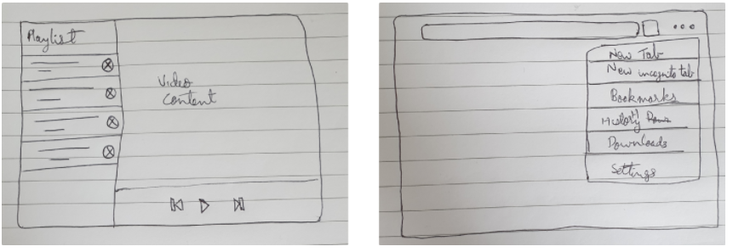
IDEATION PHASE OF THE PRODUCT:

Slide 5
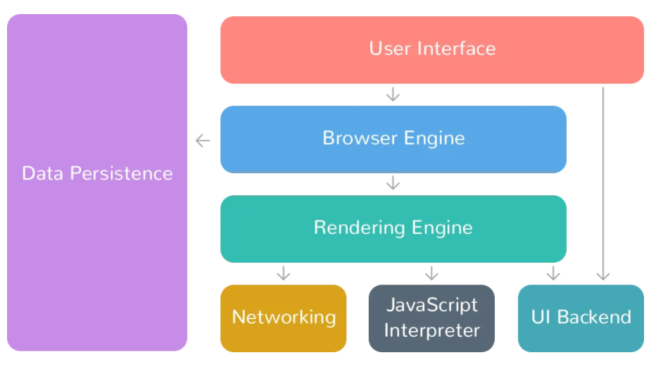
WORKFLOW:

Slide 6
COMMERICAL ADVANTAGE OF BRAVE SOFTWARE.
Search queries: 2.3 billion queries annualized. 1.3 million Verified Creators,
Brave’s ad platform, where users earn BAT by opting in to view privacy-preserving Brave Ads (70% of ad revenue share), has greatly expanded as revenue has grown 4x over the past 12 months.
Over 8 million users earning BAT via Brave Rewards.
Most mobile growth of any browser in 2021 with over 10M downloads.
Brave Ads campaigns were supported in nearly 200 countries with over 7.5 billion ad confirmation events to date.
The average click-through rate (CTR) for a Brave Ads campaign is 8%, well above the industry average of just 2%, with many brands observing even higher engagement.
The Brave Marketer Podcast is heading into its 4th season and has tripled its subscribers since its launch in March 2021

